Slide 1

Text Processing For NLP Web Scrapping
Unlock the power of natural language processing
with web scraping. Join me on a journey through the
basics and advanced techniques!

Slide 2
Introduction
The Power of Text Processing
The Need for Web Scraping
Combining Text Processing and Web Scraping
Text processing is the backbone of many NLP applications. It can help us uncover insights, identify patterns, and create meaningful data models.
Web scraping is essential for gathering large volumes of data from the internet. It's an efficient way to collect data sets for a variety of purposes.
By combining the two, we can process large amounts of data and perform powerful analyses that can improve decision making in many domains.

Slide 3
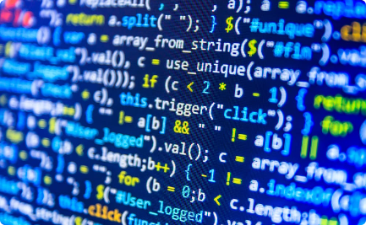


Introduction to Web Scraping
What is Web Scraping?
Why is Web Scraping Important?
How Does Web Scraping Work?
Web scraping is the process of extracting data from websites using code. It can help us collect data for analysis and research.
Web scraping can help us access data that we wouldn't otherwise have access to. It can also automate the process of data collection, saving both time and resources.
Web scraping involves using code to programmatically visit web pages, extract the data we need, and store it in a structured format for later use.

Slide 4
Web Scraping Techniques
APIs and Webhooks
Some websites provide APIs or webhooks for data access, which can be an easier alternative to web scraping.
1
2
3
Static vs. Dynamic Websites
Crawlers
Static websites are simpler to scrape, while dynamic websites require more advanced techniques.
Crawlers can be used to systematically navigate a website, extracting data and following links as they go.

Slide 5

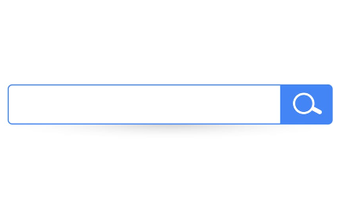
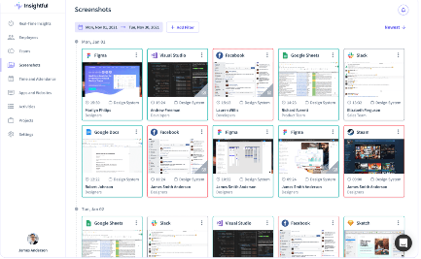
Choosing Target Websites
Defining Your Goals
Finding Relevant Websites
Monitoring for Changes
Start by identifying your research goals and the types of data that will be most useful.
Use search engines, social media, and other sources to find websites that match your research goals.
Track your target websites regularly to detect changes and stay up-to-date with the latest data.

Slide 6
Setting Up the Environment
Choosing the Right Tools
Setting Up Your Workspace
Creating a Data Pipeline
There are many web scraping tools available, each with its own strengths and weaknesses. Choose the one that's right for you.
Create a comfortable and efficient workspace with all the tools you need at your fingertips.
Think ahead and plan how you will process and store your data, including backups and security measures.

Slide 7



Basic Web Scraping with BeautifulSoup
What is BeautifulSoup?
The Basic Process
Starting Simple
BeautifulSoup is a popular Python package that simplifies the process of web scraping by parsing HTML and XML documents.
The basic process of web scraping with BeautifulSoup involves sending a request to a URL, parsing the response, and extracting the data we need.
Start with simple examples and build up your skills over time. Don't hesitate to experiment and try new things.

Slide 8
Advanced Techniques with BeautifulSoup
1
Using CSS Selectors
CSS selectors can make it easier to find specific elements on a web page, saving time and making code more efficient.
Handling Pagination
2
When scraping multiple pages, pagination can present a challenge. Simple techniques like URL manipulation and loop iteration can help.
3
Working with APIs
When available, APIs can be a simpler and more reliable way to extract data from websites.

Slide 9
Handling Dynamic Content
Identifying Dynamic Content
Dealing with JavaScript
Caching and Balancing Performance
Dynamic content is content that changes without the page reloading, such as social media feeds and news tickers.
JavaScript can be a challenge for web scraping. Selenium and other tools can help simulate a browser environment to scrape dynamic content.
Web scraping can put a strain on servers and pages. Consider using caching and rate limiting to balance performance and avoid being blocked.

Slide 10
Data Cleaning and Preprocessing
1
Why Data Cleaning is Necessary
Data cleaning involves removing irrelevant information and standardizing data to make it more consistent and useful.
Common Data Cleaning Techniques
2
Techniques like text normalization, data type conversion, and outlier removal can help clean and preprocess scraped data.
3
Validating and Testing Data
Validating and testing data can help catch errors and ensure consistency and accuracy.

Slide 11
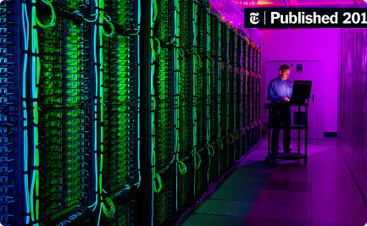
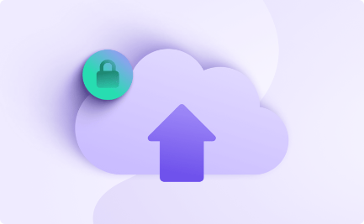

Storing Scraped Data
Storing Data Formats
Storing Data Security
Documenting Data Collection
Choose a data storage format that suits your research goals and preferences, such as CSV, JSON, or a database.
Protect your data from breaches and loss with proper security measures and backups, including using a cloud service like AWS or Azure.
Document your data collection process to ensure transparency and reproducibility, and to make sharing and reuse of the data easier.

Slide 12
Dealing with Challenges
Overcoming CAPTCHAs and Other Blocks
Working with Difficult Data
Handling Legal and Ethical Issues
Some data, such as OCR scans or handwritten documents, can be challenging to extract and clean. Tools like OpenCV and deep learning can help.
Web scraping can raise legal and ethical concerns related to privacy, ownership, and redistribution of data. Stay up-to-date with local and international regulations, and practice responsible web scraping.
Techniques like changing IP addresses, using proxies, and CAPTCHA solving services can help get around anti-scraping mechanisms.

Slide 13
Ethical Considerations
1
Respect Privacy and Ownership
Observe copyright and intellectual property rights, and avoid scraping private and confidential information.
Be Open and Transparent
2
Document your data sources and methods, and make your data accessible and reusable to the extent possible.
3
Support Fairness and Equity
Avoid using web scraping for discriminatory or harmful purposes, and aim for inclusive and unbiased research.

Slide 14
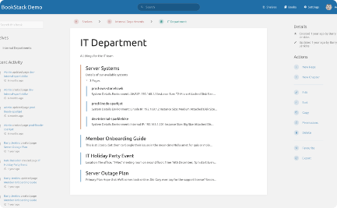


Web Scraping for NLP Applications
Text Corpora
Speech Processing
Data-driven Insights
Web scraping can help build large and diverse text corpora for NLP research and machine learning applications.
Scraped audio and text data can be used to train and evaluate speech recognition and natural language understanding models.
Scraped and processed data can help reveal patterns and trends in social media, news, and other texts, enabling data-driven insights and decision making.

Slide 15
Benefits and Limitations
Benefits
Limitations
Best Practices
Adopting best practices such as transparent and ethical web scraping, careful data cleaning and preprocessing, and reproducible workflows can help ensure successful and sustainable web scraping projects.
Web scraping can be an efficient and reliable way to collect large and diverse data sets for NLP and other research purposes.
Web scraping can be limited by the availability and quality of data, as well as by ethical, legal, and practical challenges.

Slide 16


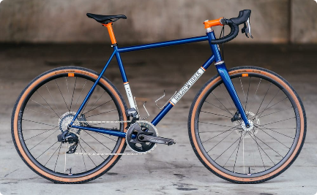
Case Studies
Web Scraping Maple Syrup Prices
Web Scraping Movie Review Data
Web Scraping Bike-Sharing Data
Scraping and analyzing prices of maple syrup can help maple producers and distributors make data-driven pricing decisions.
Scraping and analyzing movie reviews can help researchers and industry professionals understand audience preferences and trends.
Scraping and analyzing bike-sharing data can help city planners and policymakers make informed decisions about urban mobility and infrastructure.

Slide 17
Future Trends in Web Scraping
Integration with machine learning and AI
Web scraping technology can be combined with machine learning and AI to create more advanced and accurate data processing and analysis.
1
2
3
Increasing sophistication of anti-scraping technologies
Emerging ethical and legal questions
New challenges will arise as websites and services become more advanced at detecting and blocking scrapers.
New debates and discussions will arise as web scraping becomes more widespread and powerful, raising questions about privacy, ownership, and data fairness.

Slide 18

Conclusion
Web scraping is a powerful and rapidly evolving field that can unlock the potential of natural language processing and provide valuable insights for a wide range of applications. With careful planning, execution, and adherence to best practices, web scraping can be a reliable and effective research method for both seasoned and new practitioners.

